Slide 1
Nashua Athletics FY2025 Budget
Presentation to Nashua Board of Education
April 10, 2024

Slide 2
Why Education-Based Athletics?
“Last class of the day”
Front porch of the school
Extend the learning experience of the classroom
Prepare students for college, career, or military
Develop social, emotional, physical, and cognitive skills
Hold to high academic and behavior standards
Provide opportunities to
Pursue excellence in academics, sportsmanship, and athletics
Build pride within school and community
Be part of something bigger than themselves
Represent school and community by wearing a school uniform in competition

Slide 3
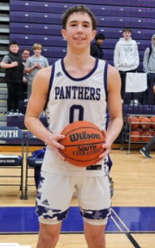
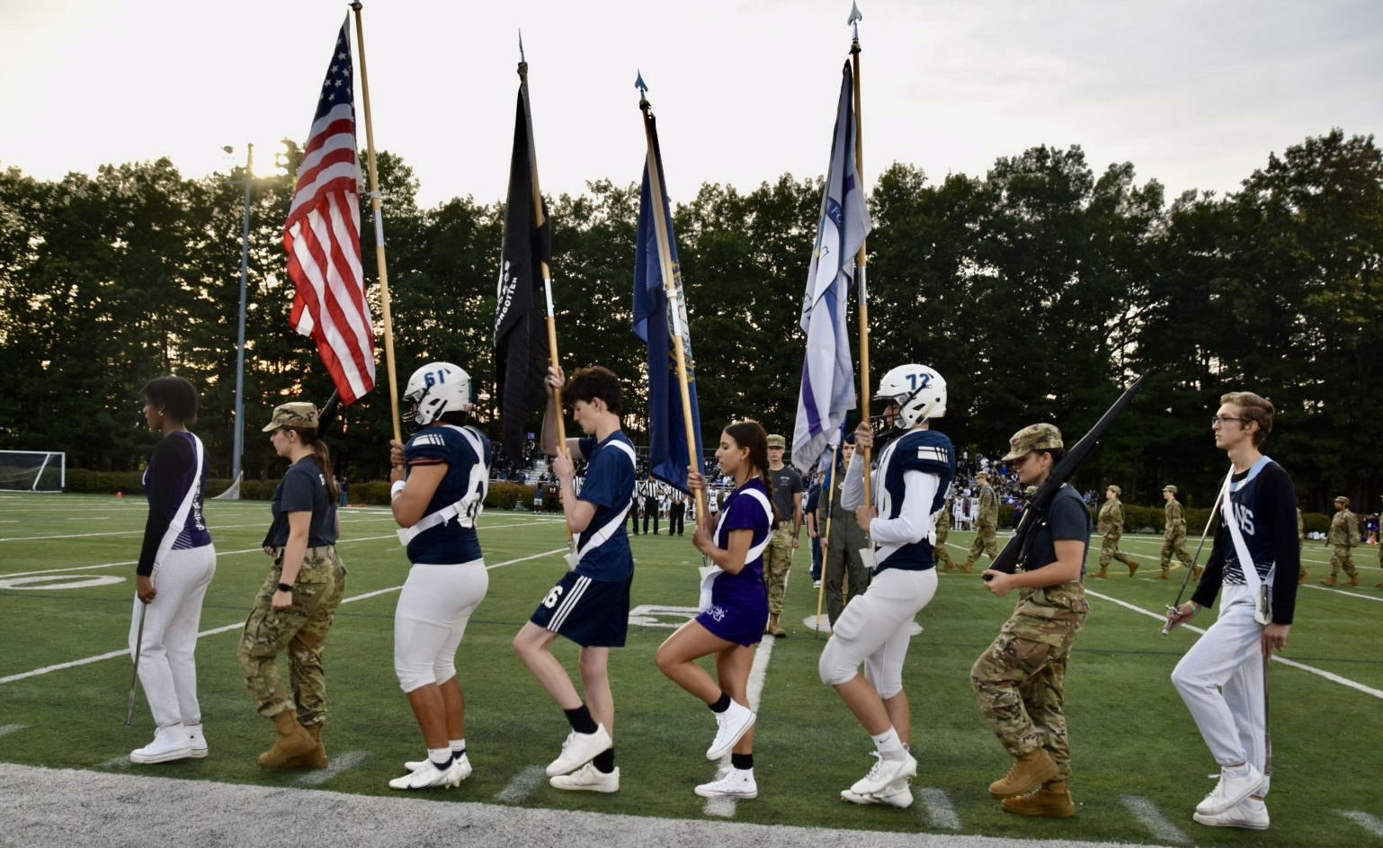
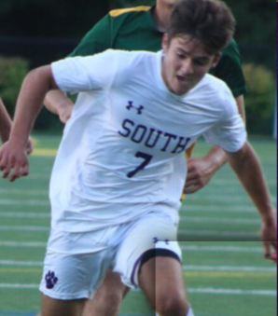
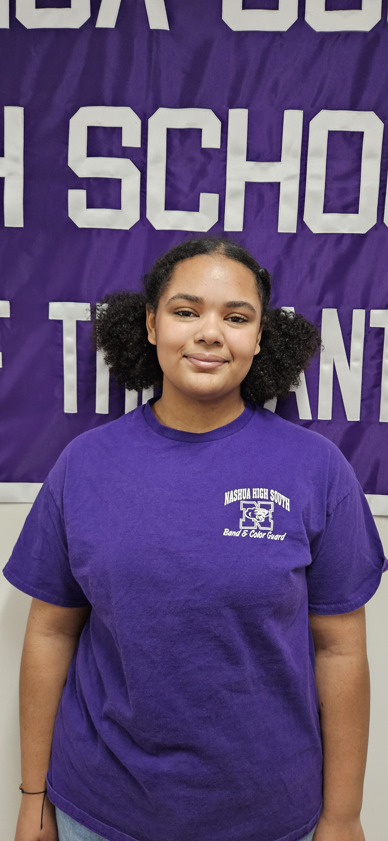
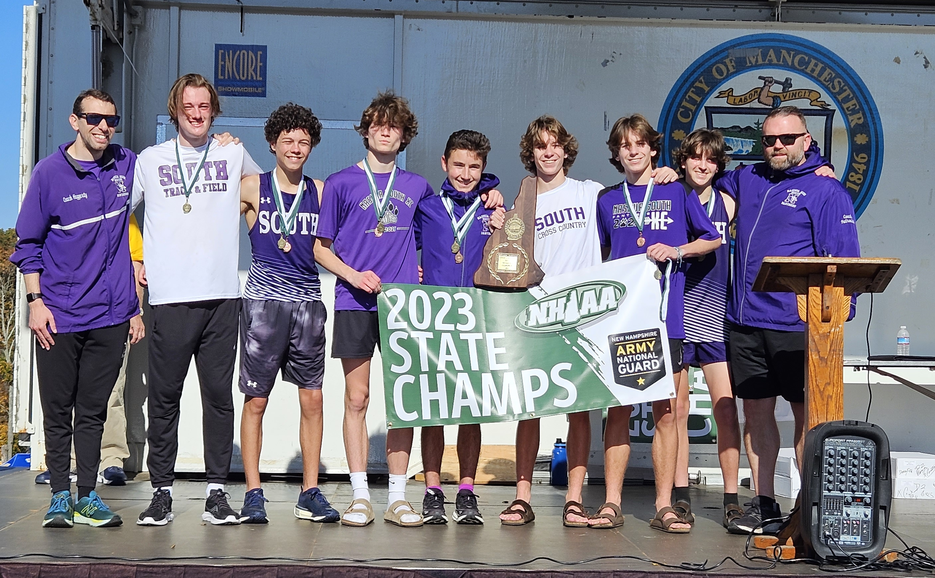

Slide 4
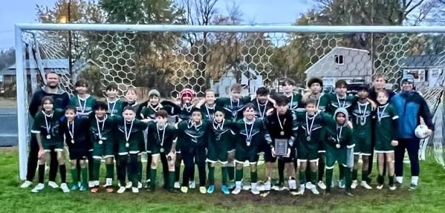
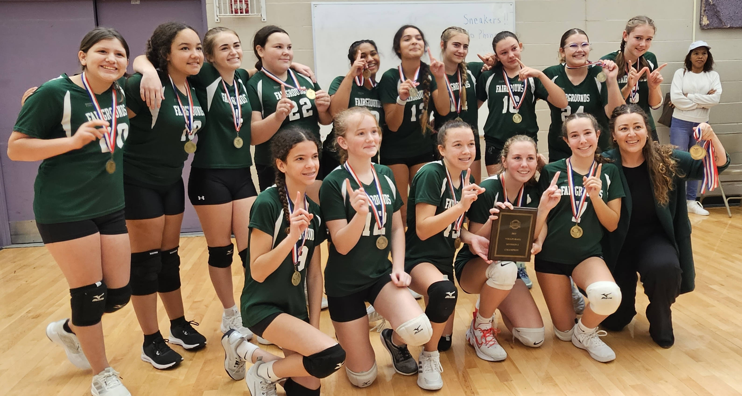
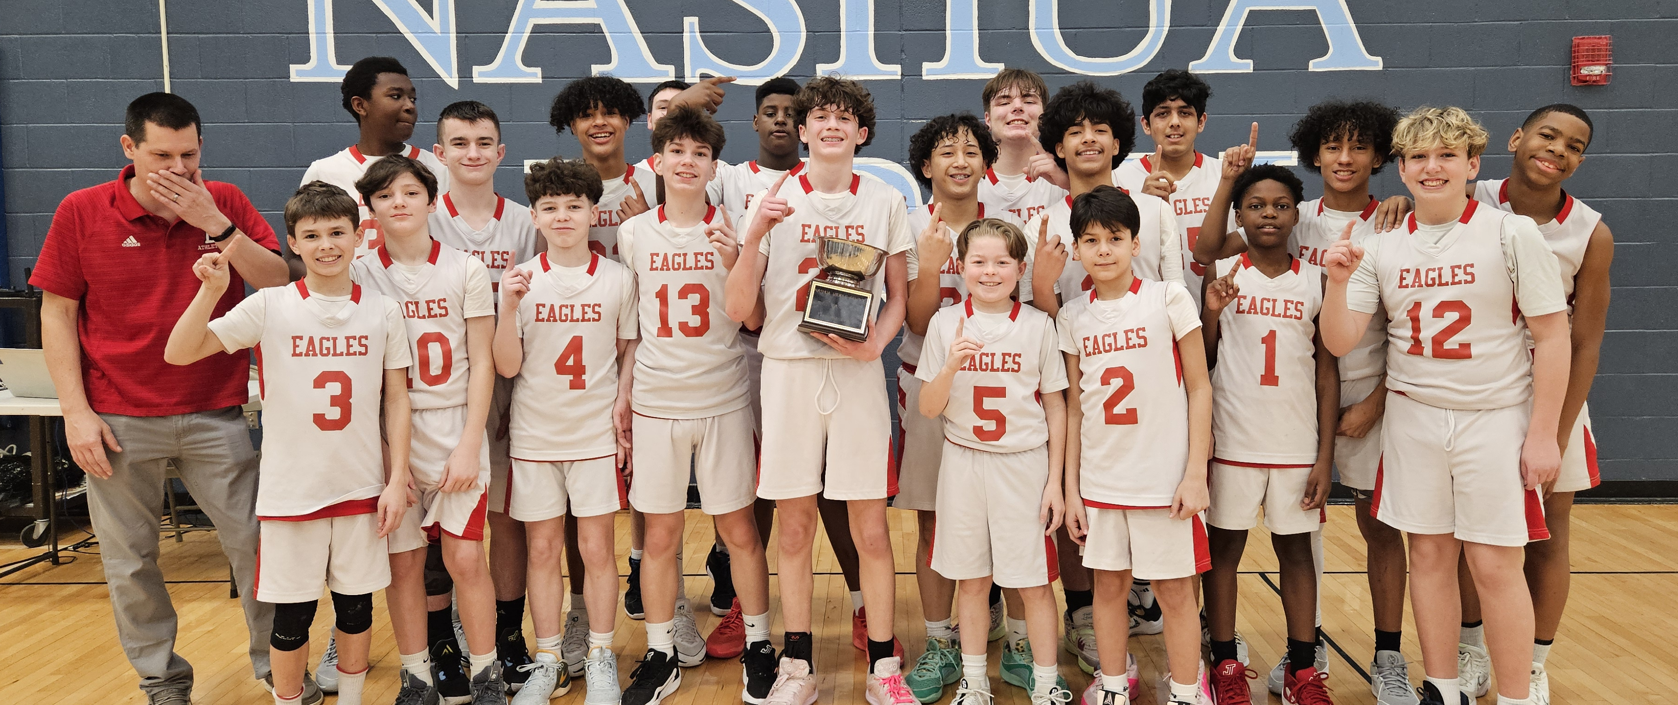

Slide 5
Why Education-Based Athletics?
Provide all students (not just student-athletes) and the community positive events
Pep rallies
Events to attend
Battle of the Bridge
Middle School City Championships
Develop these core values through athletic competition and teamwork
Accountability
Commitment
Excellence
Responsibility
Sportsmanship

Slide 6
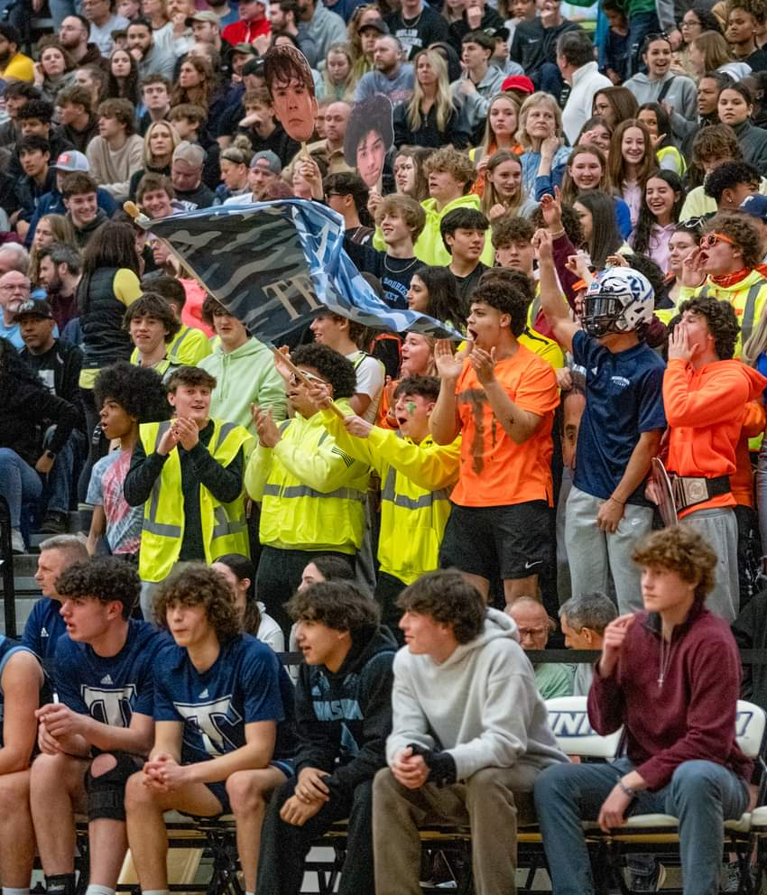

Slide 7
Participation
2022-23 school year data
High School
1651 participants
1023 individual students
178 three-season athletes
33 varsity programs at each HS
102 different teams
More than 1200 contests
66 NHIAA/NHADA Scholar-Athletes
29 Twelve-season Athletics
Middle School
652 participants
12 programs at each MS
1 program combining all 3 MS
37 different teams
Nearly 400 contests

Slide 8
Challenges
Recruiting and retaining qualified coaches
Lack of officials
Transportation concerns in other districts
Participation levels
Specialization and non-school based programs
Demands on middle and high school students outside of school
2024-25 Middle School Transition
Elm Street to McCarthy
Redistricting and its impact on the MS programs
Re-classification of our schools within the league

Slide 9
Programs for Future Consideration
High School
Boys Volleyball
Girls Ice Hockey cooperative team
Girls Flag Football
Middle School
Boys and Girls Lacrosse
Unified Basketball
Wrestling
“B” Teams

Slide 10
Positions for Future Consideration
High School Coaches
For new programs added
Strength and Conditioning Coach at each high school
Assistant Varsity coach for each program without one
Field Hockey
Soccer (boys & girls)
Basketball (boys & girls)
Baseball
Lacrosse (boys & girls)
Middle School Coaches
For new programs added
Softball
Spirit (fall & winter)
Tennis (boys & girls)
Volleyball

Slide 11
Sport Program Lines
Each program’s budget includes
Coaches’ stipends
Officials (incl. assignor fee)
Transportation
Rentals (if applicable)
Game Staff (if applicable)
Police Detail (if applicable)
The following items are NOT included in each program
Equipment maintenance and purchases
Uniforms
Athletic Training Services & Medical Supplies
Weight Room Staffing
Dues & Membership
Tournament Fees
Awards
The following sports have boys and girls programs but all is budgeted under boys
Cross Country
Alpine Ski
Indoor Track
Swim/Dive
Outdoor Track
All 3 middle schools are budgeted under the 05 location (Elm St/McCarthy)

Slide 12
Expenditures Not in the Operating Budget
Items through Special Revenue Fund or Athletic Trust
Uniforms
Awards
Large scale equipment purchases

Slide 13
Athletic Budget Summary – By Account
Please note – these numbers do not include Wages FT, FICA, pension, benefit amounts (“52” lines)
FY 2024 Budget | $1,020,272
FY 2025 Budget | $1,083,281
Difference $ | +$63,009
Difference % | +6.18%

Slide 14
Athletic Budget Summary – Labor Accounts
Please note – these numbers do not include Wages FT, FICA, pension, benefit amounts (“52” lines)
FY 2024 Budget | $1,020,272
FY 2025 Budget | $1,083,281
Difference $ | +$63,009
Difference % | +6.18%

Slide 15
Athletic Budget Summary – Non-Labor Accounts
Please note – these numbers do not include Wages FT, FICA, pension, benefit amounts (“52” lines)
FY 2024 Budget | $1,020,272
FY 2025 Budget | $1,083,281
Difference $ | +$63,009
Difference % | +6.18%

Slide 16
User Fee History – By Season
 | Fall | Winter | Spring | Total
FY2016 | $79,405 | $60,088 | $47,848 | $187,341
FY2017 | $77,780 | $60,440 | $42,975 | $181,195
FY2018 | $80,395 | $60,924 | $38,866 | $180,185
FY2019 | $72,640 | $69,935 | $41,285 | $183,860
FY2020 (no spring season) | $75,045 | $75,955 | $0 | $151,000
FY2021 (winter was refunded) | $65,498 | $0 | $40,420 | $105,915
FY2022 | $69,550 | $59,245 | $37,775 | $166,570
FY2023 | $78,970 | $57,581 | $34,083 | $170,634

Slide 17
User Fee History - Waivers
 | % of fees waived for Free or Reduced Lunch or Financial Hardship | % of fees waived for 3-season athlete, dual sport, manager | % of Unpaid Fees
FY2016 | 23.23% | 6.10% | 2.87%
FY2017 | 22.65% | 7.31% | 3.43%
FY2018 | 22.27% | 10.08% | 2.27%
FY2019 | 19.53% | 10.92% | 1.45%
FY2020 (no spring season) | 18.54% | 4.16% | 1.94%
FY2021 | 21.86% | 4.67% | 3.16%
FY2022 | 18.29% | 8.44% | 1.2%
FY2023 | 15.5% | 25.87% | 2.64%

Slide 18
Thank you! Questions?

